Slide 1
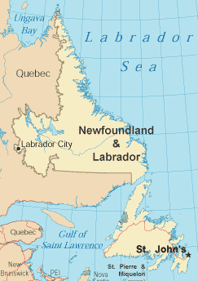
Green
FIRST IN
FAITH &
CHARITY
White
NEWFOUNDLAND - LABRADOR
Role NL on Bottom

